Slide 1
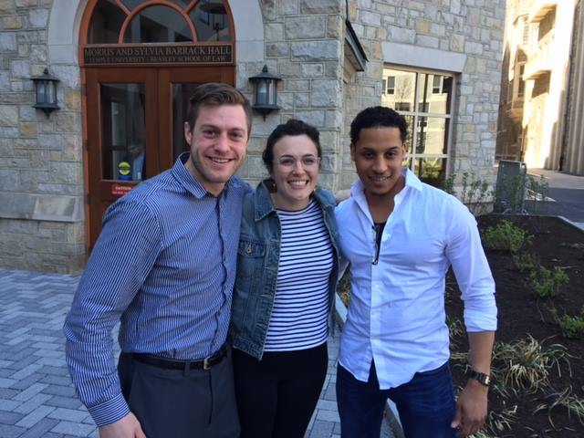
In-House Clinics Temple Law School Fall Semester 2021

Slide 2
What are the in-house clinics?
BE THE LAWYER!
Get academic credit for practical lawyering experience
Learn intensively by engaging in legal research and advocacy in real-life settings
Have real responsibility for your own clients
Clinics are taught by law school faculty that are focused on your individual learning and growth as a lawyer.

Slide 3
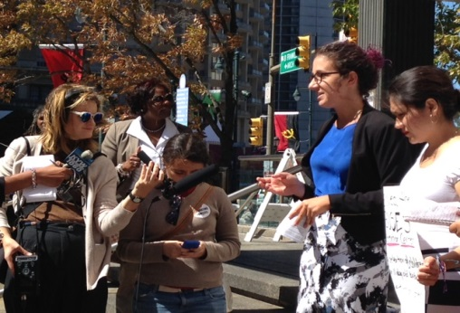
What kind of work do students do?
Client-centered representation
Developing case theory and project plans
Interviewing, counseling, negotiating, litigating
Engaging in community education, policy, or legislative advocacy work

Slide 4
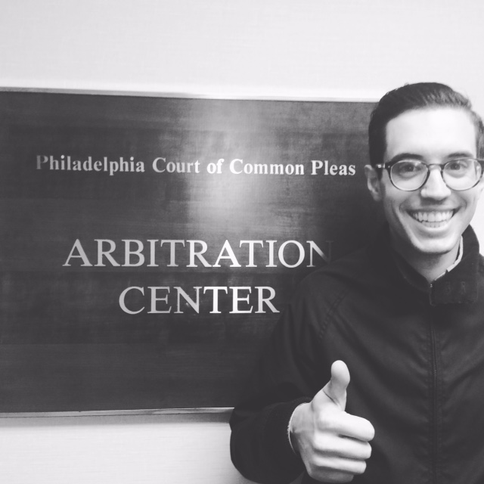
What happens in the seminar?
Learning practical skills and values
Reflecting on experiences, providing mutual support for problem-solving
Critiquing the legal system

Slide 5
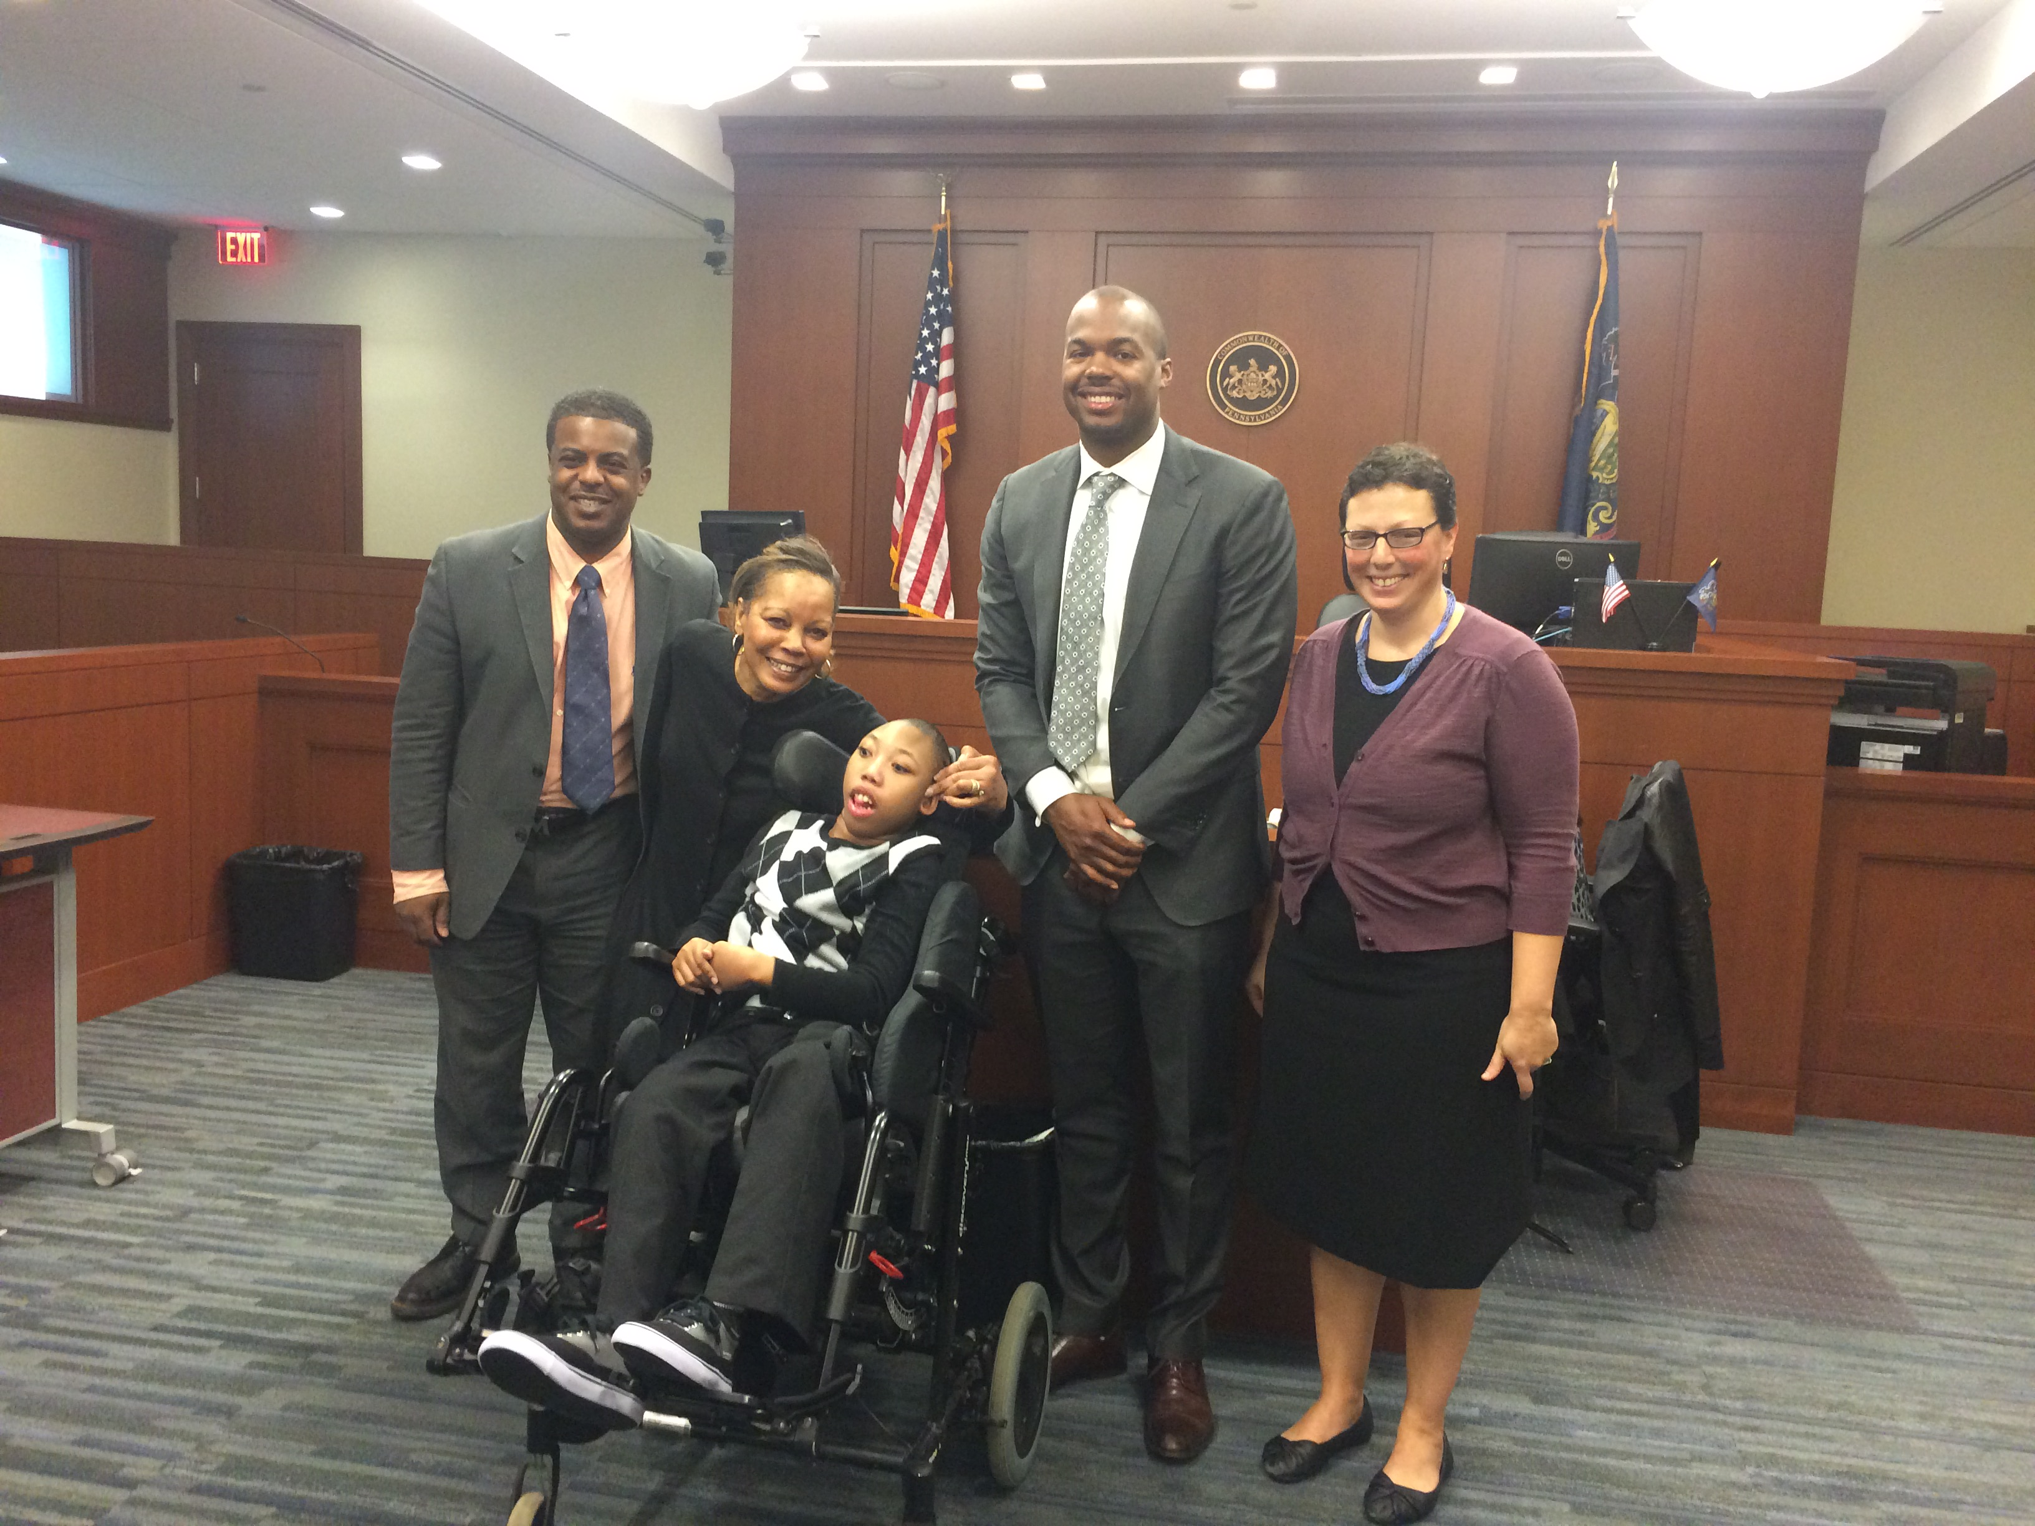
How does supervision work?
Regular meetings with faculty for feedback
Reviewing the legal and ethical implications of the steps you are taking for your clients
Support on problem solving (not micromanagement)

Slide 6
How many clinics in the spring?
Seven clinics in Fall 2021:
Access to Justice Clinic (Sheller Center)
Community Lawyering Clinic (Temple Legal Aid)
Family Law Litigation Clinic (Temple Legal Aid)
Federal Appellate Litigation Clinic
Low Income Taxpayer Clinic (LITC)
Social Justice Lawyering Clinic (Sheller Center)
Systemic Justice Clinic (Sheller Center)
Offered other semesters: Elderly Law Clinic
All clinics at Temple serve underserved clients or communities

Slide 7
How are the clinics different?
Go to Temple’s
In-House Clinics to learn more about the differences between clinics.
Credits
Grading
Certification requirements or other prerequisites
Offered only in the fall or spring

Slide 8
How do I apply for the fall?
DEADLINE: March 17, 2021 at 5 pm
Fill out an application.
Submit by the deadline.
NOTIFICATION: March 24, 2021
Students will be notified about acceptances.
Some clinics may notify students that they are on a wait list.
DEADLINE FOR STUDENTS TO CONFIRM: March 29, 2021
Students will accept/decline clinic spots.
The student will be directly registered for the clinic by the registrar.

Slide 9
How do I get more information?
Contact the professor directing the clinic:
Talk to students who have taken the clinic
Read more about the clinics on Temple’s In-House Clinics Page
Clinic | Professor
Access to Justice | Len Rieser, lrieser@temple.edu
Community Lawyering | Spencer Rand, spencer.rand@temple.edu
Elderly Law | Debby Kroll, dkroll@temple.edu
Family Law Litigation | Sarah Katz, sarah.katz@temple.edu
Federal Appellate Litigation | Mary Levy, mary.levy@temple.edu
Low Income Taxpayer Clinic | Matthew T. James, mtj@temple.edu
Social Justice Lawyering | Jennifer Lee, jenniferjlee@temple.edu
Systemic Justice | Shanda Sibley, shanda.sibley@temple.edu

