Slide 1
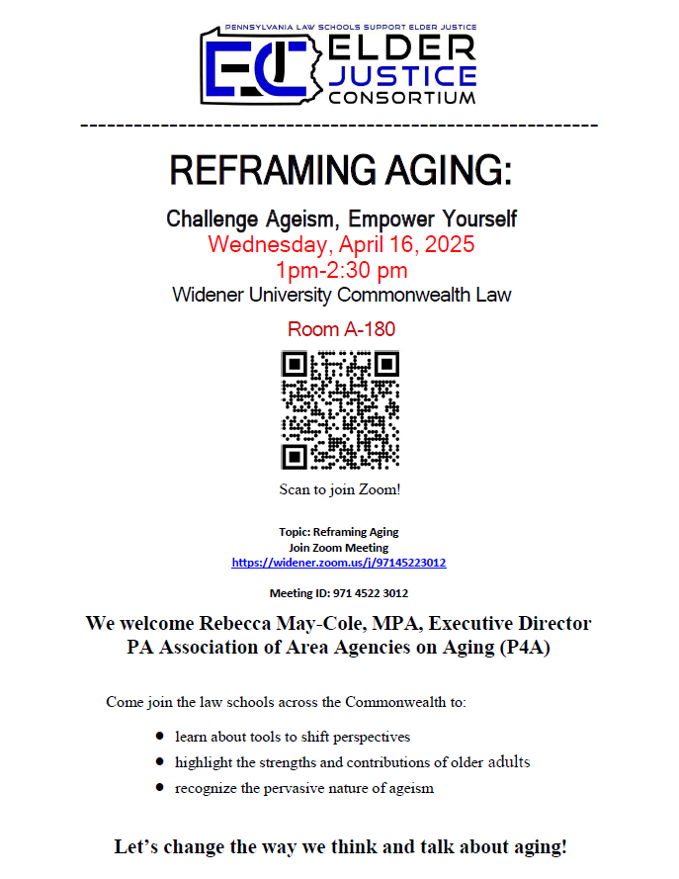
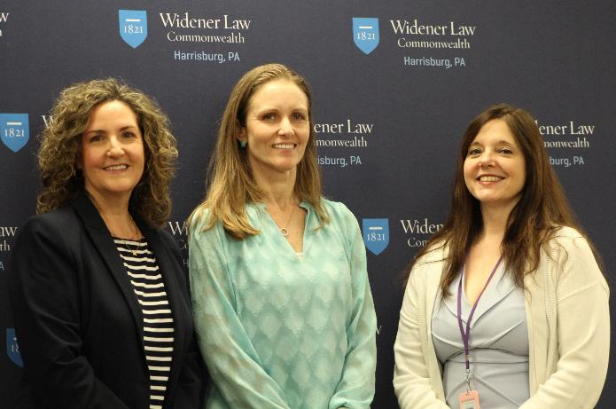
Professor Mary Catherine Scott, Commonwealth Law
Rebecca May-Cole, PA Association of Area Agencies on Aging
Amy Whitworth, Executive Director, Office of Elder Justice in the Courts

