Slide 1

National Healthcare Decisions Day
April 16, 2024
Created with Microsoft Image Designer:
“thinking about healthcare decisions”

Slide 2
Introductions
Grace Orsatti (EJC) * Mary Catherine Scott (EJC)
Katherine Pearson (EJC) * Spencer Rand (Temple Legal Aid Office)
Brendan Corbalis (SeniorLaw Center)
Monica Harmon (Drexel’s Dornsife Center) * Kate Norton (EJC)
Eliza Hens-Greco and Nick Piccirillo (Duquesne Kline Students)
Members of EJC at each Pennsylvania Law School
***
Today
A little bit about EJC
Elder Law
Healthcare Decisions & Directives

Slide 3










School of Law
Dickinson Law

Slide 4
Unified goals
“larger impact”
“stronger, critical support for older Pennsylvanians”
“advice, advocacy, and education”
“inspire students to continue work following transition to attorney”
---
“Our law schools have united around the goal of providing stronger, critical support for older Pennsylvanians through advice, advocacy, and education, with the hope of ultimately inspiring our students in this effort to continue this work after their transition from law student to attorney.”

Slide 5
Your involvement
Interested in this work – let us know!
  Nortonk1@duq.edu (Prof. Kate Norton)
  Orsattig@duq.edu (Prof. Grace Orsatti)
  mcscott9055@widener.edu (Prof. Mary Catherine Scott)
Website in development (thank you Temple!)
  Space for short student publications
    blogs about experiences
    hot topics
  Community events
  Pro bono opportunities

Slide 6
Elder law

Slide 7

What is the practice of Elder Law
Created with Microsoft Image Designer:
“what is elder law”

Slide 8

The need … the risks why is this stuff so important
https://www.pacourts.us/judicial-administration/court-programs/office-of-elder-justice-in-the-courts

Slide 9
National Healthcare Decisions day

Slide 10

*an annual initiative celebrated on April 16th to encourage and empower people to begin conversations about their wishes for care through the end of life.
-The Conversation Project
(https://theconversationproject.org)

Slide 11
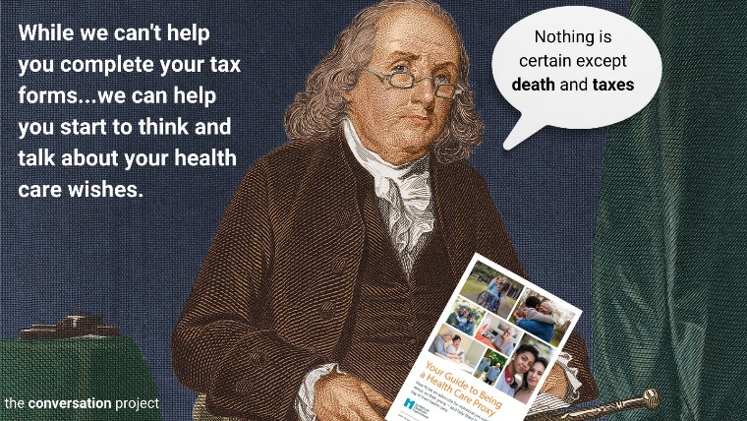
“The date was set in 2008, by attorney Nathan Kottkamp, based on the Benjamin Franklin quote that “[I]n this world, nothing is certain except death and taxes.” So, do your taxes each year by the 15th and review your health care wishes each year on the 16th. We want to normalize reviewing this each year and recognize that wishes or the people in your life may change.” –the conversation project

Slide 12
Decisions and Directives

Slide 13
What & why & Who
What are they?
What do they cover?
Why have them?
Who should have them?

Slide 14
Perspectives
Lawyers
Healthcare
Providers
Teachers
Students

Slide 15
What do they look like
Why types of information do they include
  How much/how little
How do you develop these
ACBA (handout available at some locations)
  https://www.acba.org/wp-content/uploads/2023/04/ACBA_PoALivingWill.pdf

Slide 16
QUESTIONS

Slide 17
THANK YOU!

