Slide 1


Immigration Enforcement at Work:
Worker-Focused Training/Toolkit
on behalf of the
April 2025

Slide 2
Intro & Goals
Introduction
Goals:
(1) KYR if ICE shows up at work
(2) How workers can demand that their employer adopt policies to protect immigrant workers

Slide 3
KYR if ICE Shows Up
at Work

Slide 4
Background: ICE Enforcement
Who is ICE?
Immigration and Customs Enforcement (ICE) is a federal agency that enforces federal immigration laws
How does ICE enforce federal immigration law at work?
I-9 audits
Workplace raids

Slide 5
Background: I-9 Audits
1. Notice of inspection
  ICE shows up or sends a notice requiring production of employer I-9 forms.
  By law employer have 3 business days to respond.
  Employers do not have to keep copies of a worker’s ID or work authorization, or provide more info than is requested
2. Inspection of forms
  ICE inspects the forms for technical or substantive violations
3. Violations
  When violations are found, an employer is given 10 business days to make corrections.
  Employers will be required to stop the unlawful activity of employing, may be fined, and in rare situations may be criminally prosecuted.

Slide 6

Background: Workplace Raids
What are workplace raids?
Unannounced and surprise worksite visit
Agents may seek a specific employee
Agents may more generally seek to identify employees without lawful status
How do ICE agents operate?
May be wearing uniforms or in plain clothes
May carry weapons
May try to talk to employees and employer
Two ways for ICE to enter your workplace:
(1) A valid judicial warrant
(2) Permission from your employer
Serge Averbukh
IMPORTANT:
All agents must carry an identification badge

Slide 7
Basic Constitutional Rights: Workplace Raids
Constitutional rights apply regardless of immigration status
Right to remain silent
Everyone retains the right to remain silent by refusing to speak to ICE agents during a workplace raids
Right to refuse entry into private areas
ICE agents may only enter private areas with consent or with a valid judicial warrant

Slide 8
Basic Constitutional Rights:
Public Areas vs. Private Areas
Private Areas
Where only staff is permitted. Physically separated from areas open to the general public.
Examples:
  Kitchen in restaurant
  Supply room in retail store
Public Areas
Where members of the public, such as customers, are permitted
Examples:
  Dining room in restaurant
  Shopping aisles in retail store
ICE needs judicial warrant or permission for private areas

Slide 9
Basic Constitutional Rights:
Judicial vs. ICE Warrant
Judicial warrants may authorize more extensive and invasive ICE action.
Issued by U.S. court
Signed by federal judge
States who/what ICE is searching for
States where agents can search
ICE administrative warrants do not authorize agents to enter private areas. Administrative warrants ONLY authorize ICE to detain a specific person.

Slide 10
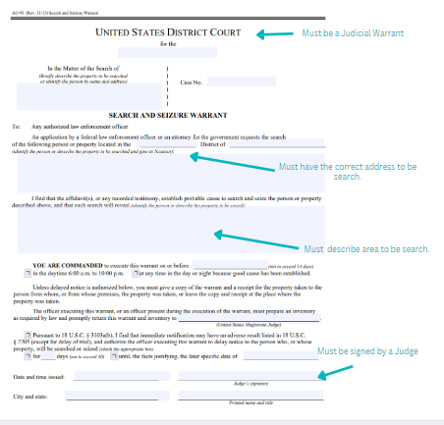
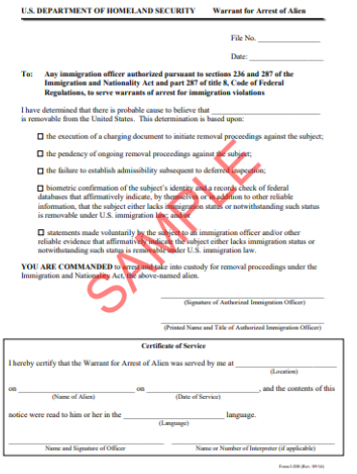
Basic Constitutional Rights:
Judicial vs. ICE Warrant

Slide 11
What can you or your boss do about an ICE raid?

Slide 12
Before Raid: Workers
Understand your workplace policies if you have any about ICE encounters
Organize your workplace so that you and your coworkers are working together
Establish a point person to interact with ICE agents
Identify local immigration attorneys & immigrant rights organizations able to provide help in the event of a raid
Compile information into a written response plan
Post a written response plan in areas where workers are allowed to post other personal information

Slide 13
Before Raid: Employers
Clearly mark private areas with visible signs and do not allow the public to enter those areas without permission.
Commit to requiring a judicial warrant for ICE to access private area.
Establish emergency protocols.
Train workers on how to handle ICE and about emergency protocols.
Compile information into written response plan in areas accessible to employees and practice with employees.

Slide 14
During Raid: Workers
Stay calm and stay silent
Remind each other that you do not have to talk to ICE agents
Wait in private areas
No one should run away as it gives ICE agents the justification to detain, arrest, and enter private areas
Assign a point person to speak with ICE agents
Ask agent for identification
Record encounter (if safe)
Video recording or taking notes about the conduct of ICE agents can later serve as evidence

Slide 15
During Raid: Employers
Require a judicial warrant
Examine the warrant to see whether it is judicial or administrative
Observe whether ICE is complying with what’s written in the warrant (e.g., the person, documents, or address listed)
If ICE is searching something else, object to those searches
Do not talk to or help ICE when you don’t have to
With an administrative warrant for a specific person, you do not have to say if an employee is working on that day or take them to that employee
Do not help ICE by providing information about your employees, such as name, immigration status, country of origin, or home address
Record encounter (if safe)
Video recording or taking notes about the conduct of ICE agents may later serve as evidence.

Slide 16
Post Raid: Employer
Record all facts about raid immediately after (including saving copies of security footage of raid)
Notify family members about any detained employee
Help secure legal assistance for employees
Contact immigration attorney or immigrant rights organization for help post raid
Offer leave to affected employees
Grant workers leave to get their affairs in order
Pay owed & separation wages

Slide 17
Worker Organizing:
Get Your Employer to Agree to Best Practices

Slide 18
Worker Organizing:
Demand Best Practices
Workers can organize and demand that the bosses commit to key actions that protect immigrant workers
Workers collectively are powerful
Individual workers too may have leverage that can create pressure on bosses to ensure best practices
Even if you do not succeed, workers can still organize among themselves to engage in best practices

Slide 19
Worker Organizing:
What Are Some of the Asks?
  Does your workplace have private areas?
    If no → organize to have your boss create and label private areas
  Does your workplace have a policy about ICE warrants?
    If no → organize to demand that your boss commit to a policy that only allows ICE access to private areas with a signed judicial warrant
  Does your workplace have an emergency plan?
    If no → organize to have clear emergency plans in place for all types of potential emergencies
  Do your employer, manager, and coworkers know about these rights?
    If no → organize to demand that your boss get everyone trained

Slide 20
Worker Organizing: How to Do It?
Talk to your coworkers. 1:1 conversations are the best way to build up collective support.
→Attend an organizing training with EWOC or Labor Notes for free support in building organizing skills or look at their online resources.
Identify collectively what you as workers want to see at your workplace for an ICE raids plan.
Come up together with how you will make your demands (e.g., oral request, petition) and whether you are willing to escalate to others kind of pressure if the employer does not agree. Ensure that your are engaging in protected concerted activity with coworkers.

Slide 21
Worker Organizing:
You Have Rights as Employees
Section 7 rights of the National Labor Relations Act (NLRA)*
  Protects employees who engage in concerted activity at work for the purpose of mutual aid or protection
  Protects employees from retaliation
  *NLRA has some exemptions for independent contractors, farm workers, domestic workers, and undocumented workers*
U.S. citizens (and other workers with lawful work authorization) may be better able to wield their privilege to make collective demands

Slide 22
Worker Organizing:
Model Employer Plan/Policy
See Sample Model Policy Handout!
Demand that your employer agree to certain policies. For example:
  ICE is not allowed into private areas without a judicial warrant
  No information about any employees, such as their name, immigration status, or address, will be shared with ICE without a judicial warrant or subpoena or unless it is part of an I-9 audit
  Non-retaliation leave and separation and pay policies for workers impacted by ICE raids
Demand that your employer come up with an ICE raids plan. For example:
  Create and label private areas
  Have a protocol in place, including designated people that will handle any ICE interactions at the workplace
  Train all workers and supervisors about the plan
  Put the plan in writing and translate into other languages

Slide 23
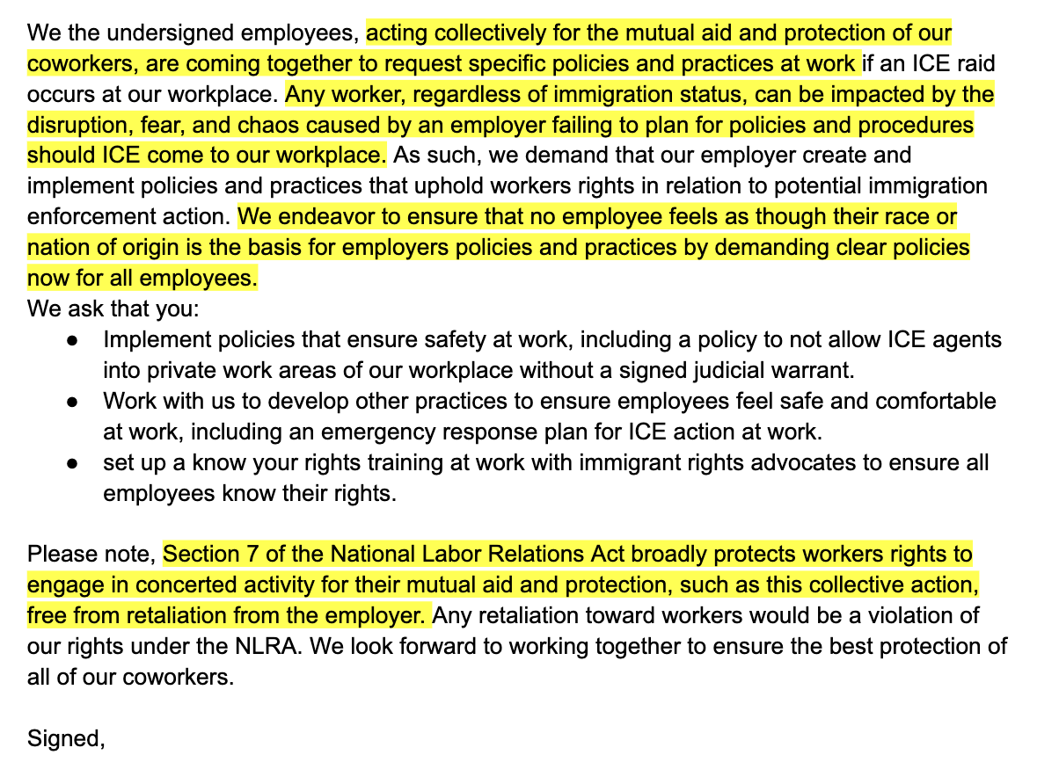
Worker Organizing:
Sample Petition to Employer
Highlights reference to key legal language that action is taken for the mutual aid and protection of workers and is activity that is protected by the NLRA.

Slide 24
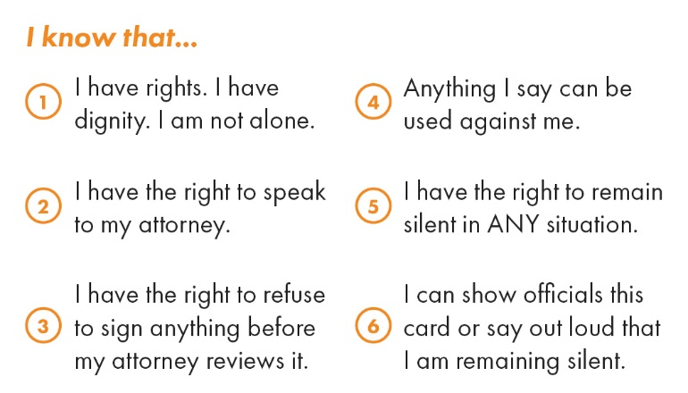
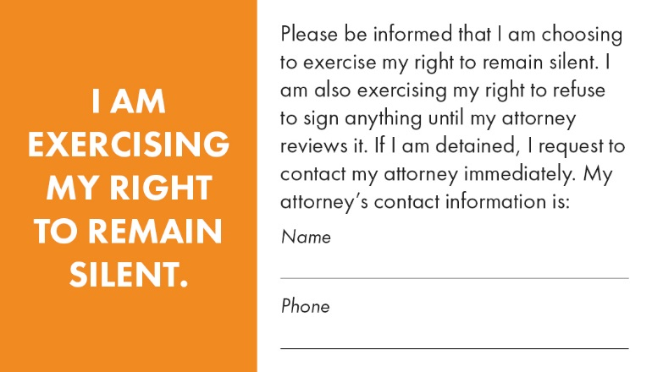

Resources: KYR Wallet Cards
Available in multiple languages!

Slide 25
Resources: immigration organizations
For general information on your rights during an ICE raid, please visit:
National Immigration Law Center
https://www.nilc.org/issues/immigration-
enforcement/
American Civil Liberties Union
https://www.aclu.org/know-your-rights/i
mmigrants-rights
For immigration organizations that provide direct representation to immigrants, please visit:
HIAS Pennsylvania
https://hiaspa.org/
Esperanza Immigration Legal Services
http://www.esperanza.us/eils/
Nationalities Service Center
https://nscphila.org/

Slide 26
Resources: worker organizing
For general information and support on how to organize at work, please visit:
Emergency Worker Organizing Committee (EWOC)
Organizing resources:
https://workerorganizing.org/resources/training/
Organizing Trainings:
https://workerorganizing.org/training/
Labor Notes
Organizing resources (english and spanish) :
https://labornotes.org/secrets/handouts
Organizing trainings:
https://labornotes.org/events

